Slide 1
Status Report: Hybrid Montgomery Algorithm
Kartik Agarwal 2018102017
Aniketh Reddimi 2018102014

Slide 2
Overview
Recent progress
Implementation of 1024-bit hybrid algorithm for better encryption of cryptosystems.
Reduced the time taken by x% in comparison with Montgomery algorithm
Biggest risk
Developing our own hybrid version par with research oriented Montgomery algorithm

Slide 3
What is Montgomery Algorithm and why should we care.
Quantum computation is on rise and cryptographic protocols are in danger. Using the best supercomputer out there, it takes more than a billion years to break the RSA-2048 protocol.
Casually, RSA encryption is given by ciphertext = (plaintext)^{d} mod n where ciphertext, plaintext and n are 2048 bit numbers.

Slide 4
Continued.
On the hardware analysis, it is relatively tougher to implement modular exponentiation for large scale bits. Hence, we chose an algorithm which makes the exponentiation easier for hardware (time based, not power)
Using the ordinary Montgomery algorithm and the Hybrid algorithm, the CPU cycles are improved by 36% and 40% respectively.

Slide 5
Progress - Adder
Accomplishment 1
Built a 1024-bit adder with unconventional xor and bit shifting properties.
Implemented the parallel prefix Kogge-stone adder which has the minimum fan-out
Accomplishment 2
Improved the computational time by 45.33% with respect to CSA (carry save adder) and 32.01% with respect to RCA (ripple carry adder).

Slide 6
Progress - Hybrid Algorithm
Accomplishment 1
On par with multiple implementations of Montgomery algorithm w.r.t research papers.
Using a larger radix 2^{n+2} instead of the conventional 2^{n} to attain “zeroing out” solution
Accomplishment 2
We studied the paper, derived our ideas and expanded them in such a way to improve time complexity minding the space complexity.

Slide 7
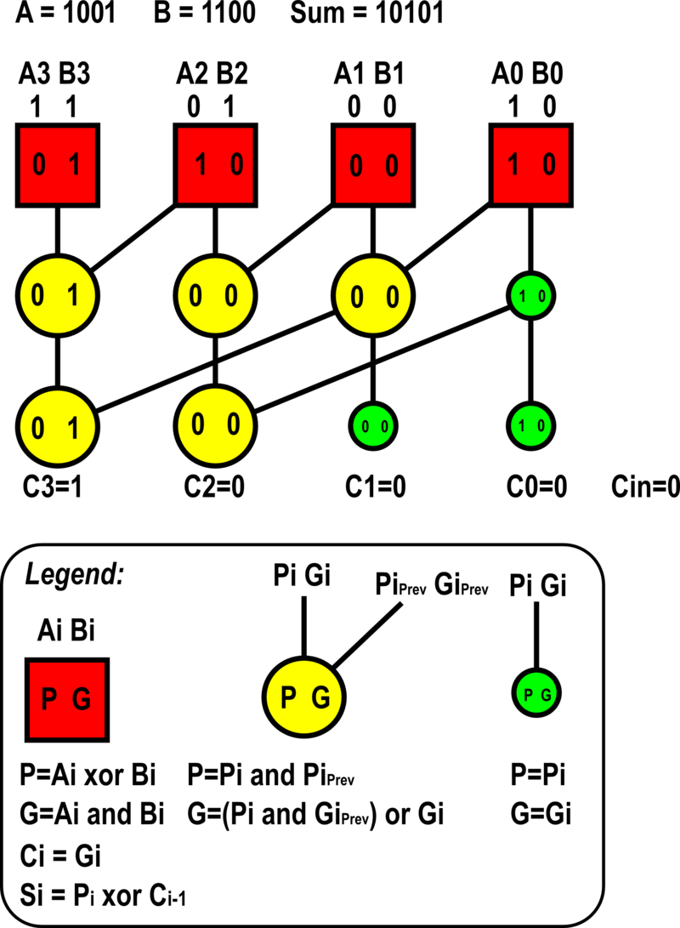
Kogge Stone Adder

Slide 8
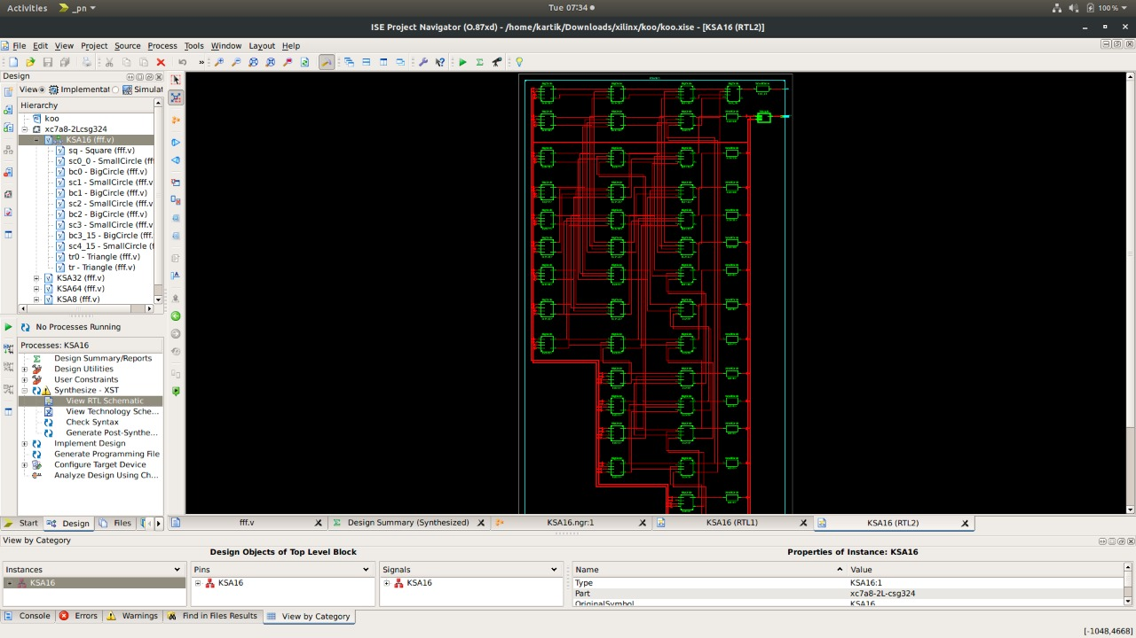
16-bit Kogge Stone Adder

Slide 9
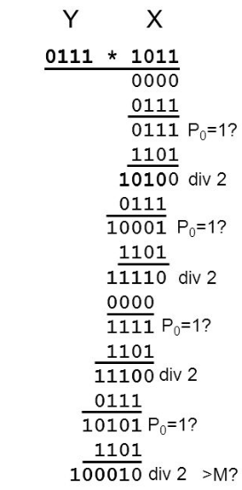
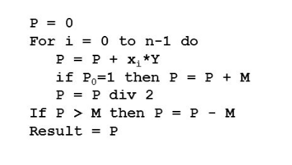

Normal Montgomery Algorithm

Slide 10
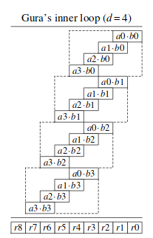
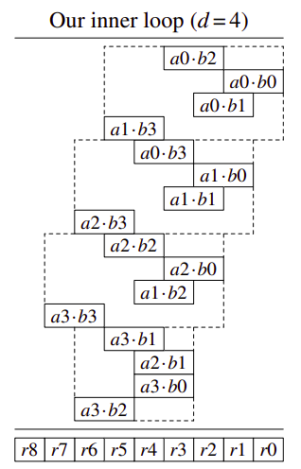
Our Algorithm for 8 bits and carry

Slide 11
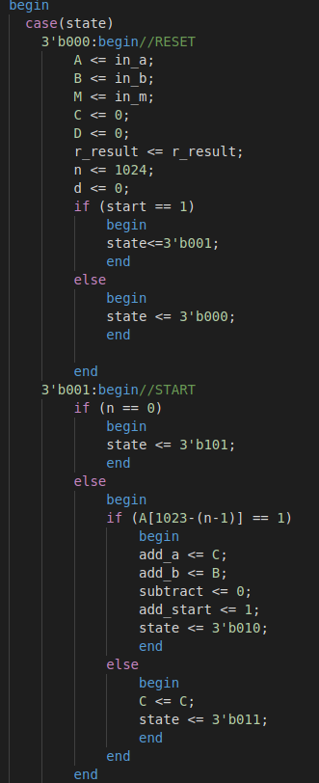
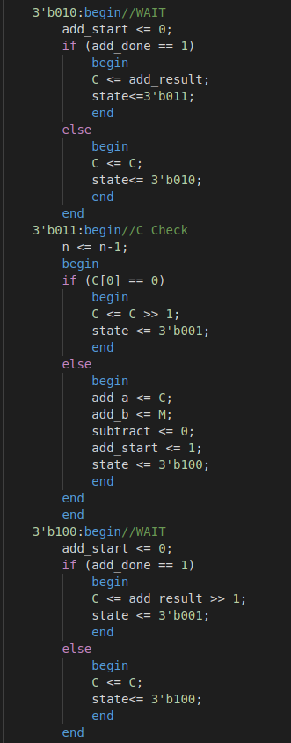
Hybrid Algorithms verilog code

Slide 12
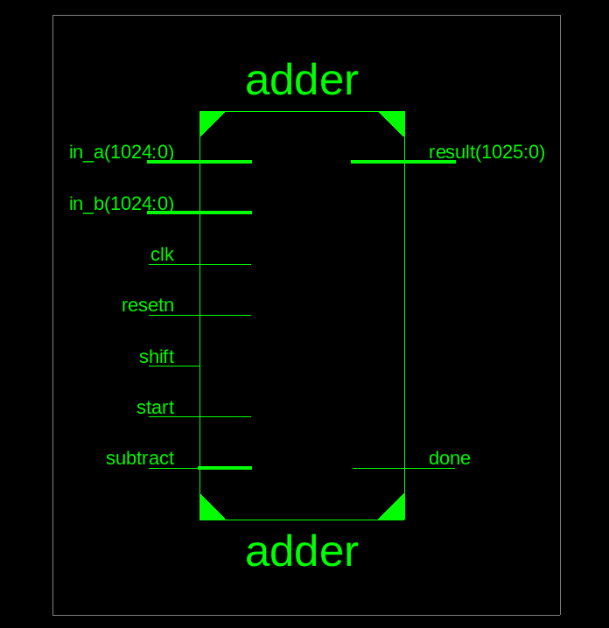
RTL Schematic of 1024 bit Adder

Slide 13
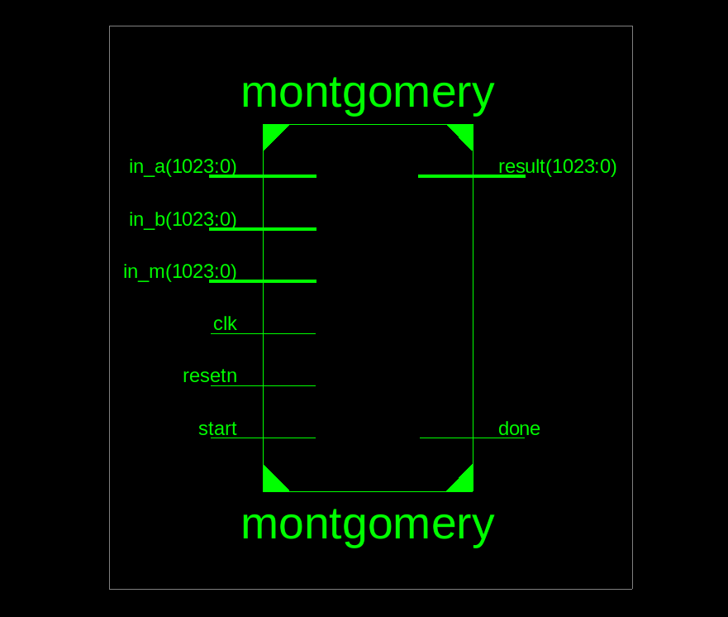
RTL Schematic of 1024 bit Montgomery

Slide 14
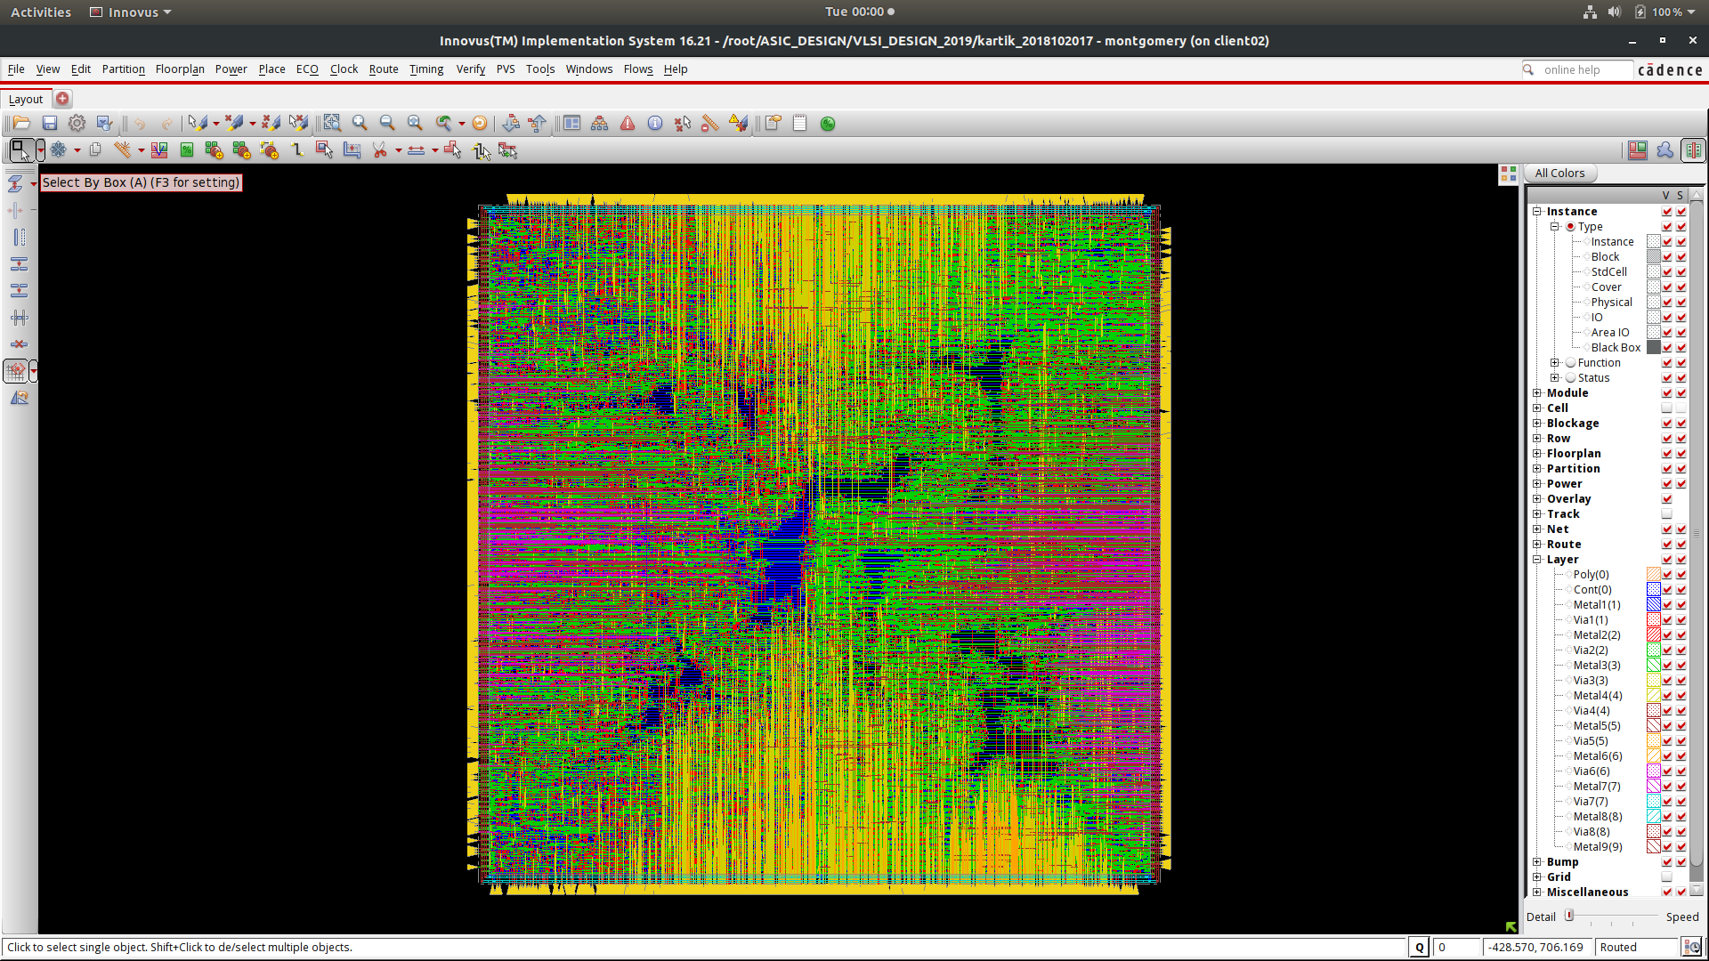
Innovus

Slide 15
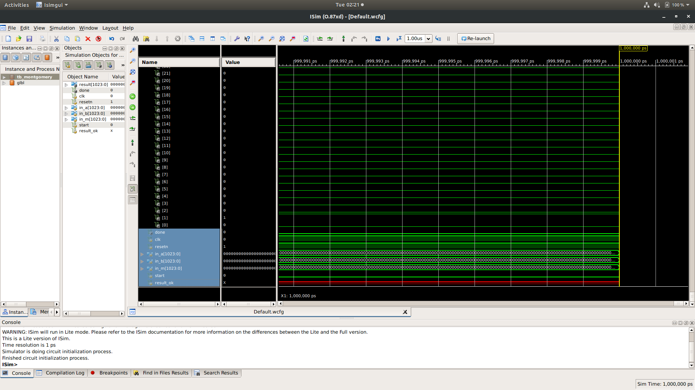
Timing Diagram
Of
1024 bits
Algorithm

Slide 16
MULTIPLIER | Area | DELAY
Normal Montgomery Multiplier | No. of Slice Registers Used : 69 No. of Slice LUTs Used : 270 No. of bonded IOBs : 195 | 41.702ns
Hybrid Montgomery Multiplier | No. of Slice Registers Used : 81 No. of Slice LUTs Used : 227 No. of bonded IOBs : 131 | 32.55ns
Comparison Table

Slide 17
References
Y. Zhang and J. Großsch ̈adl. Efficient prime-field arithmetic for elliptic curve cryptography on wireless sensor nodes. In Proceedings of the 1st International Conference on Computer Science and Network Technology (ICCSNT 2011), volume 1, pages 459–466. IEEE, 2011.
C ̧ . K. Ko ̧c, T. Acar, and B. S. Kaliski. Analyzing and comparing Montgomery multiplication algorithms.IEEE Micro, 16(3):26–33, June 1996.
P. S. Barreto, H. Y. Kim, B. Lynn, and M. Scott. Efficient algorithms for pairing-based cryptosystems. In M. Yung, editor,Advances in Cryptology — Crypto 2002, volume 2442 of Lecture Notes in Computer Science, pages 354–368. Springer Verlag, 2002.
M. Hutter and E. Wenger. Fast multi-precision multiplication for public-key cryptography on embedded microprocessors. In B. Preneel and T. Takagi, editors,Cryptographic Hardware and Embedded Systems — CHES 2011, volume 6917 of Lecture Notes in Computer Science, pages 459–474. Springer Verlag, 2011.

Slide 18
Thank You!

